Slide 1
Weather to Wear
CS639
Petergail McFayden

Slide 2
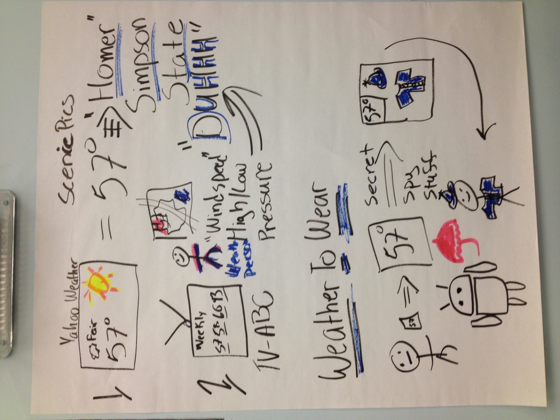
Concept Board
Create an application that would give a visual display of weather recommendations
Imager is based of no clothing and accessory item recommendations
Minimize user input

Slide 3
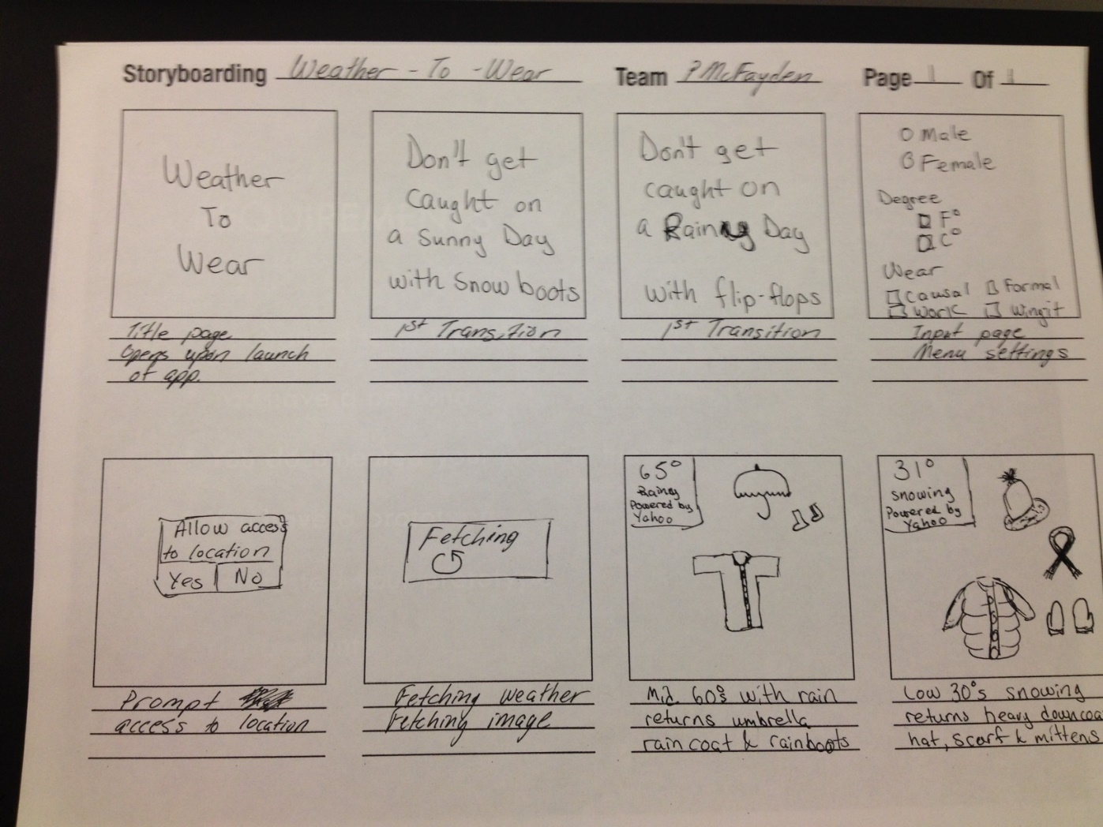
Story Board

Slide 4
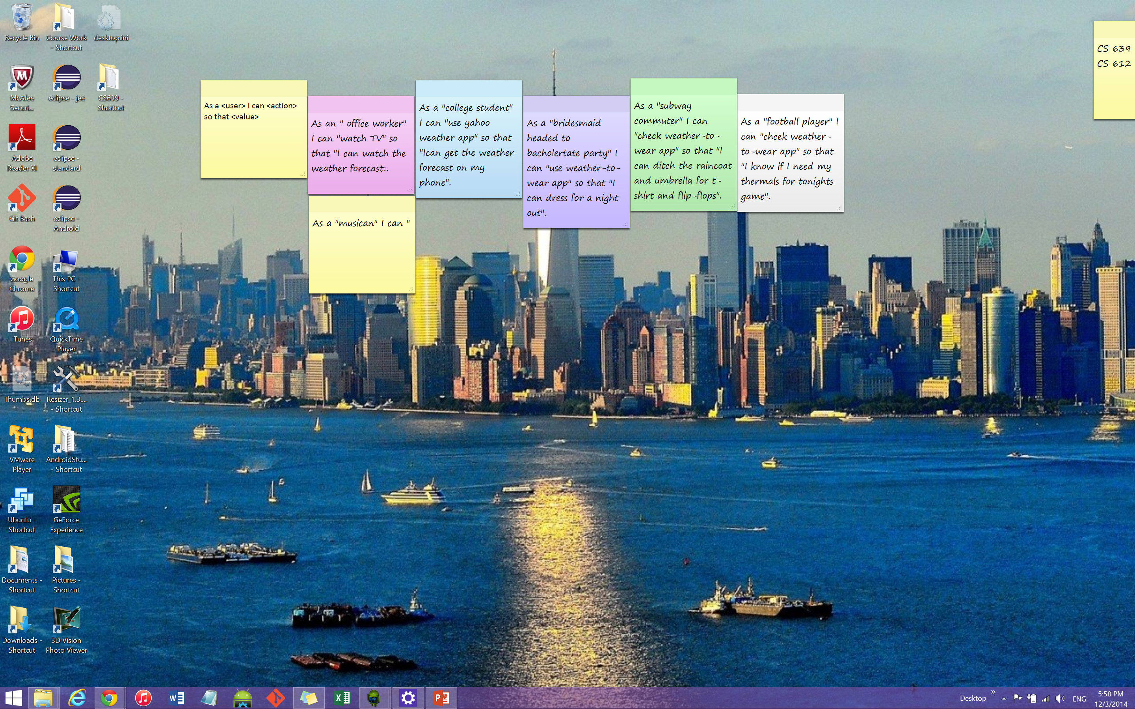
Post Its

Slide 5
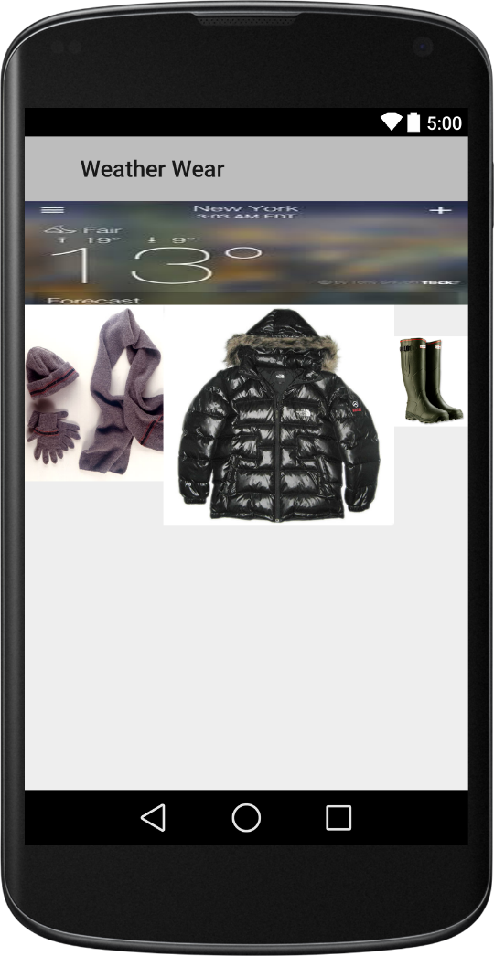
Rough Draft

Slide 6
Stages of development hurdles
Addressing how generate users location for accurate weather forecast
Access the mobile devices GPS
Still working the bugs out of that
Hard cord the location from a user interface
Trying to minimize user input, will use as last resort
Choosing reliable online weather source
Yahoo Weather API
Connecting to Yahoo Weather API
Got that figured out
Working on the location issue, in order to pull current forecast
Visual Basic
Make it look appealing to broad audience
Have to overlay the wear imagery over the weather image

Slide 7
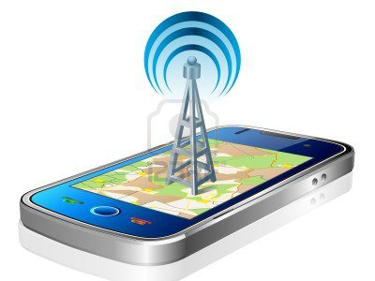

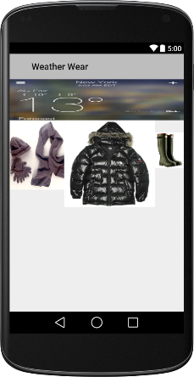
Info follow

